Slide 1

VNR Vignana Jyothi Institute of Engineering and Technology
Department of Computer Science and Engineering
Major Project
on
Sentimental analysis based on Movie Recommendation System using Graph Neural Network
Under the guidance
of
Mrs. A Madhavi Dr K Srinivas
Assistant Professor Assistant Professor
By
T Bindhu Bhargavi
(22071D5803)

Slide 2
Abstract
Movie recommendation system that leverages sentiment analysis and Graph Neural Networks (GNNs) to provide personalized movie recommendations based on user sentiments. The system aims to enhance the movie-watching experience by analyzing sentiments expressed in movie reviews or social media posts. By incorporating a GNN, the system can capture complex relationships between movies, users, and sentiments, enabling it to make more accurate and personalized recommendations. The sentiment analysis component processes textual data, extracting sentiments, and associating them with corresponding movies. The GNN model is then trained on a graph representation of the movie-user-sentiment network to learn and predict user preferences based on sentiments. Experimental evaluation demonstrates the effectiveness of the proposed system in providing sentiment-aware movie recommendations. The results highlight the potential of sentiment analysis and GNNs in improving movie recommendation systems, providing personalized watchlits and enhancing user satisfaction.

Slide 3
Objectives
1. Provide personalized movie recommendations based on users' preferences and sentiments expressed in reviews. [Watchlist and multiple watchlist based on the genre]
2. To share the movie which they are interested to watch [Sharing option to friends].

Slide 4
S.No | Title of the Paper and authors | Name of the Journal/Year of publishing | Methodology used | Scope of the paper | Findings | Limitations | Contributions
1. | Collaborative Filtering Movies Recommendation System based on Graph Neural Network. Authors Redwane Nesmaouia,∗ , Mouad Louhichia , Mohamed Lazaar | Elsevier, ScienceDirect International Conference on Ambient Systems, Networks and Technologies (ANT) 2023 Source Link: https://www.sciencedirect.com/science/article/pii/S1877050923005938 | LightGCN Movies Recommendation System. | Focuses on providing recommendations for new or unknown items to users based on their preferences | Used only LGCN for embedding representation of users. | Dividing users into multiple subgraphs can affect the efficiency of the recommendations because of the loss of information | Handling large amounts of data by reducing the number of elements and improving efficiency, feature extraction, and accuracy. Focus on providing movie recommendations using graph neural networks, which do not require the entire rating matrix as input and can infer ratings for specific user-item combinations

Slide 5
S.No | Title of the Paper and authors | Name of the Journal/Year of publishing | Methodology used | Scope of the paper | Findings | Limitations | Contributions
2. | A Survey of Graph Neural Networks for Recommender Systems: Challenges, Methods, and Directions Authors Hen Gao, Yu Zheng, Nian Li, Yinfeng Li, Yingrong Qin, Jinghua Piao, Yuhan Quan, Jianxin Chang, Depeng Jin, Xiangnan He, Yong Li | “ACM Transactions on Recommender Systems”, 2023 Source Link: A Survey of Graph Neural Networks for Recommender Systems: Challenges, Methods, and Directions | ACM Transactions on Recommender Systems | Graph construction, Embedding propagation/ aggregation, model optimization, and computation efficiency | Categorizing the works based on stage, scenario, objective, and application. | Improving diversity Cross-Domain Recommendation.(single-target CDR (STCDR) and dual-target CDR (DTCDR)) Multi-behavior Recommendation. | The development of deeper models, addressing challenges, exploring new recommendation objectives, and considering the sequential recommendation. | Due to the over-smoothing problem, more and more studies focus on properly increasing GNN’s layers to capture higher-order connectivity correlations on graphs as well as improve models’ performance

Slide 6
S.No | Title of the Paper and authors | Name of the Journal/Year of publishing | Methodology used | Scope of the paper | Limitations | Contributions
3. | Contrastive Multi-Level Graph Neural Networks for Session-based Recommendation. Authors Fuyun Wang; Xingyu Gao; Zhenyu Chen; Lei Lyu | “IEEE” 2023 Source Link: Contrastive Multi-Level Graph Neural Networks for Session-based Recommendation | IEEE Journals & Magazine | IEEE Xplore | Session-based recommendation (SBR) Contrastive multi-level graph neural networks (CM-GNN) to better exploit complex and high-order item transition information. | The proposed method applies a local-level graph convolutional network (L-GCN) and a global-level network (G-GCN) to capture pairwise relations over all sessions, and a hyper-level graph convolutional network (H-GCN) to capture high-order information among item transitions. | The development of deeper models, addressing challenges, exploring new recommendation objectives, and considering the sequential recommendation. | CM-GNN also introduces an attention-based fusion module to learn pairwise relation-based session representation

Slide 7
S.No | Title of the Paper and authors | Name of the Journal/Year of publishing | Methodology used | Scope of the paper | Limitations | Contributions
4. | Movie Popularity and Target Audience Prediction Using the Content-Based Recommender System Authors Sandipan Sahu 1 , Raghvendra Kumar1 , Mohd Shafi Pathan2 , Jana Shafi 3 , Yogesh Kumar4 , And Muhammad Fazal Ijaz5 | “IEEE” 2022 | CNN deep learning model for movie popularity prediction. | The potential of predictive and prescriptive data analytics in supporting industry decisions in the movie sector. | It is unclear whether the recommender system takes into account user preferences or feedback, which could limit its ability to provide personalized recommendations. | Fuzzy C-Mean clustering was used to calculate the movie preference for each age group and determine the target audience of the movie.

Slide 8
S.No | Title of the Paper and authors | Name of the Journal/Year of publishing | Methodology used | Scope of the paper | Limitations | Contributions
5. | Enhancing Performance of Movie Recommendations Using LSTM With Meta Path Analysis Authors Zulfiqar Ali 1 , Asif Muhammad 2 , Ahmad Sami Al-shamayleh 3 , Kashif Naseer Qureshi 4, Wagdi Alrawagfeh 5 , And Adnan Akhunzada 5 , (Senior Member, IEEE). | IEEE 2023 | LSTM-IIMA (Long Short-Term Memory-Inter Intra-metapath Aggregation) for movie recommendation systems, which incorporates intra and inter-metapath analysis to capture complex linkages and dependencies between movies, users, and other things | Mainly focuses on enhancing the performance of movie recommendations using LSTM with meta path analysis. It proposes a novel technique called LSTM-IIMA (Long Short-Term Memory-Inter Intra-metapath Aggregation) for movie recommendation systems.. | Computational Complexity. | Overfitting: Like other deep learning models, LSTMs are susceptible to overfitting when there is insufficient training data. Regularization techniques like dropout can help mitigate this issue.

Slide 9
S.No | Title of the Paper and authors | Name of the Journal/Year of publishing | Methodology used | Scope of the paper | Limitations | Contributions
6. | LASGRec: A Personalized Recommender Based on Learnable Attribute Sampling and Graph Neural Network Authors Yufeng Wang , Member, IEEE, Xun Huang , Jianhua Ma , Senior Member, IEEE, and Qun Jin , Senior Member, IEEE | IEEE 2023 | LASGRec, which is based on learnable attribute sampling and a heterogeneous graph neural network (GNN) . | The evaluations can be conducted to compare LASGRec with other state-of-the-art recommendation schemes, including deep neural network (DNN) and GNN-based approaches, on different datasets and scenarios to gain a deeper understanding of its performance and effectiveness | LASGRec assumes the attributes of items to be static and fixed, which may not hold true in real-world recommender systems working for a long term.

Slide 10
S.No | Title of the Paper and authors | Name of the Journal/Year of publishing | Methodology used | Scope of the paper | Limitations | Contributions
7. | Digital Movie Recommendation Algorithm Based on Big Data Platform. Authors Guojian Miao , 1 Yin Gao,2 and Zhenshen Zhu | Hindawi 2022 | It utilizes a deeper depth than traditional automatic coding networks and incorporates a new activation function to generate a depth feature vector. | Optimizes the autoencoder neural network in deep learning and proposes two recommendation algorithms based on autoencoders, which to some extent improves the performance of traditional algorithms and several newer algorithms. | It highlights the potential limitations of the research, such as the insufficient utilization rate of the algorithm on the dataset and the lack of consideration for attributes like age, gender, and occupation. | Including the integration of interest transfer models and semantic analysis models to enhance recommendation accuracy and algorithm diversity

Slide 11
S.No | Title of the Paper and authors | Name of the Journal/Year of publishing | Methodology used | Scope of the paper | Limitations | Contributions
8. | Hybrid Recommendation System using Graph Neural Network and BERT Embeddings Authors Shashidhar Reddy Javaji Krutika Sarode. | International Journal of Research Publication and Reviews. 2023 | The features of anime and user interactions with different anime, enabling it to capture both inter-level and intra-level features of anime data. | The system's efficiency is further boosted by utilizing a mix of similarity measures, which can produce greater user similarity than a single similarity measure. One such similarity measure, RJMSD, was created by the author and has only ever been used to the recommendation of movies.. | It does not provide details about the size or diversity of the dataset used for training and evaluation, which could affect the generalizability of the model. | In this the model which combines a Graph Neural Network (GNN) with sentence transformer embeddings to predict anime recommendations for users.

Slide 12
S.No | Title of the Paper and authors | Name of the Journal/Year of publishing | Methodology used | Scope of the paper | Limitations | Contributions
9. | Dynamic Graph Neural Networks for Sequential Recommendation Authors Mengqi Zhang, Shu Wu, Member, IEEE, Xueli Yu, Qiang Liu, Member, IEEE, Liang Wang, Fellow, IEEE Source: https://arxiv.org/pdf/2104.07368.pdf | JOURNAL OF LATEX CLASS FILES, 2021 | Dynamic Graph Recommendation Network to extract user's preferences from the dynamic graph, converting the next-item prediction task in sequential recommendation into a link prediction between the user node and the item node in a dynamic graph. | It addresses the limitation of existing methods that only model users' interests within their own sequences and ignore the dynamic collaborative signals among different user sequences. | Methods do not effectively explore users' preferences as they do not consider the dynamic nature of user preferences that change over time and vary with the historical interacted items | Dynamic Graph Neural Network for Sequential Recommendation (DGSR) that connects different user sequences through a dynamic graph structure, exploring the interactive behavior of users and items with time and order information

Slide 13
S.No | Title of the Paper and authors | Name of the Journal/Year of publishing | Methodology used | Scope of the paper | Limitations | Contributions
10. | Knowledge-aware attentional neural network for review-based movie recommendation with explanation. Authors Yun Liu & Jun Miyazaki | Springer 2023 | Dynamic Graph Recommendation Network to extract user's preferences from the dynamic graph, converting the next-item prediction task in sequential recommendation into a link prediction between the user node and the item node in a dynamic graph. | It addresses the limitation of existing methods that only model users' interests within their own sequences and ignore the dynamic collaborative signals among different user sequences. | Methods do not effectively explore users' preferences as they do not consider the dynamic nature of user preferences that change over time and vary with the historical interacted items | Dynamic Graph Neural Network for Sequential Recommendation (DGSR) that connects different user sequences through a dynamic graph structure, exploring the interactive behavior of users and items with time and order information

Slide 14
Research Gaps
1. Sentiment-based User Profiling: Analyze the sentiment of user interactions, such as reviews, ratings, or comments, to create personalized user profiles. This can help capture individual preferences and tailor recommendations accordingly.
3. Sentiment-based Similarity Measures: Use sentiment analysis to calculate similarity scores between users, items, or interactions. This can help identify users with similar sentiment patterns and recommend items that align with their preferences.
4. Sentiment-aware Content Filtering: Apply sentiment analysis to filter out content that may have negative sentiment or is not aligned with the user's preferences. This can ensure that the recommended items are more relevant and enjoyable for the user.
5. Sentiment-based Social Influence: Consider the sentiment of social connections and their influence on user preferences. By analyzing the sentiment of friends or influencers, the system can recommend items that are more likely to be well-received by the user.

Slide 15
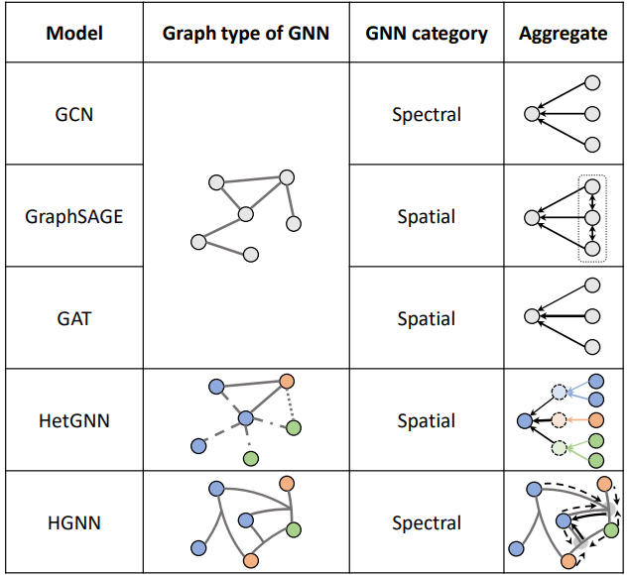
Types of GNN

Slide 16
Overall View of Proposed System
Data representation: The system uses a graph-based representation to capture the relationships between movies, users, and their sentiments. Each node in the graph represents a movie or a user, and edges represent interactions or sentiment connections.
Graph Neural Networks: GNNs are employed to learn the representations of nodes in the graph. GNNs aggregate information from neighboring nodes to capture the sentiment patterns and relationships in the graph.
Sentiment propagation: The learned representations are then used to propagate sentiments through the graph, allowing the system to capture the sentiment influence between movies and users. This helps in understanding how sentiments are connected and how they impact movie recommendations.
Sentiment-aware recommendation: The sentiment information is integrated into the recommendation process. The system leverages the learned sentiment representations to provide personalized movie recommendations based on user preferences and sentiment alignment.
Training and evaluation: The system is trained using labeled sentiment data and evaluated based on metrics like accuracy, precision, recall, or F1 score to measure the effectiveness of sentiment analysis and recommendation performance.

Slide 17
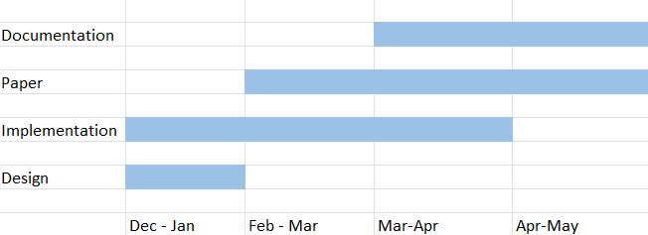
Time-plan Schedule for Major-Project

Slide 18
Any Suggestions?

Slide 19
Thank You

